Slide 1

MEDILOCATE
Adriana Carolina Garcia Serrano
(200535537)
Software Engineering Management
(ENSE 374)

Slide 2

AGENDA
Introduction
Problem Definition
Design Requirements
Solutions
Project Management
Conclusion and Future Work

Slide 3


INTRODUCTION
50+ Study Program
MediLocate is a web-based application designed to streamline how Canadians book medical appointments, addressing common frustrations like long wait times and communication barriers. Traditional appointment booking methods are often inefficient, leaving patients frustrated and clinics overwhelmed. MediLocate offers a user-friendly platform for patients to easily schedule appointments and for medical staff to manage their availability.
The rationale for this project stems from the urgent need to modernize healthcare access. With the rise of digital solutions, there’s a clear demand for a platform that simplifies the booking process while maintaining flexibility and reliability for both patients and healthcare providers. MediLocate’s design aims to fill this gap by providing a seamless and accessible solution.

Slide 4

PROBLEM DEFINITION
Canada’s healthcare system struggles with accessibility. With only 2.6 physicians per 1,000 people, the demand for medical services far outstrips the supply. Nearly 30% of Canadians report trouble accessing care, and 20% of patients experience delays of over a week just to see a family doctor. This imbalance frustrates patients and sometimes prevents them from receiving critical care.
The impact is widespread:
Patients’ Health: Delayed care can worsen medical conditions, increase anxiety, and lower quality of life.
Rural Disparities: People in remote areas face even more obstacles, with fewer healthcare facilities and long travel times.
Clinic Operations: Manual appointment scheduling adds administrative strain, increases errors, and reduces efficiency.
Provider Burnout: Overloaded clinics struggle to manage patient flow, often leading to staff burnout and declining care quality.
Without an efficient system, patients and providers both suffer from mismanaged resources and unmet needs.

Slide 5

DESIGN REQUIREMENTS
Primary Goal: Develop a user-friendly web application to help users locate doctors and schedule appointments efficiently.
Secondary Goals: Ensure seamless user experience for both patients and medical staff. Enable real-time updates for appointment changes .Provide a secure login system for patients and medical staff. Use MVC architecture for maintainability and scalability
Objectives For Patients: Allow patients to search for medical services based on specialization, location, or availability. Let patients book cancel appointments easily. Display relevant service information.
For Medical Staff: Enable medical staff to manage their availability. Provide tools to update appointment statuses in real-time.
General Functionality: Implement a login and user role management system. Design a database with multiple table relationships to handle user data, schedules, and doctor profiles.
UI/UX Goals: Make the interface clean and intuitive. Use visual cues for real-time updates (e.g., notification banners or updated schedules).
Testing and Deployment: Conduct thorough testing for user roles, database interactions, and edge cases. Deploy the app on a hosting service for accessibility.

Slide 6

CONSTRAINTS
Technical Constraints:
Must use ASP.NET Web Forms for the application.
Database operations should be performed using stored procedures.
Incorporate an MVC architecture.
Time Constraint:
The project must be completed by November 26.
Team Constraint:
Limited team participation.
Lack of experience and time.
Feature Constraints:
Real-time updates for changes must be functional.

Slide 7

SOLUTIONS
Solution 1
Our initial solution was a basic platform allowing patients to search for clinics by specialty and location and view the services offered by each clinic. This system aimed to provide patients with a centralized place to access clinic information.
Reasons for Not Selecting: While the idea improved access to clinic details, it lacked essential features for an effective healthcare platform.
Booking Functionality:
Patients could view clinic information but had no option to book appointments directly, requiring them to contact clinics manually.
Dynamic Scheduling Options:
Clinics could not adjust service flexibly to reflect changes.
These limitations hindered the platform from addressing the full needs of both patients and providers, leading us to develop a more comprehensive solution.
Without these features, the solution wouldn't provide the full value needed for a seamless healthcare

Slide 8
SOLUTIONS
Solution 2
The second solution improved upon the first by integrating an interactive map using the Google Maps API, displaying clinics near a user's location. This approach provided a more intuitive and visual way for patients to find and book appointments with local clinics, offering details like addresses, operating hours, and available services. Additionally, we planned accessibility features such as text-to-speech for visually impaired users.
Challenges:
Integrating Google Maps with real-time scheduling data was complex and could create maintenance challenges.
Development time for accessibility features would require additional resources and testing.
This solution addressed usability and accessibility, but the technical complexities and additional time needed for accessibility features meant it wasn't quite the best fit for the project at this stage.

Slide 9
SOLUTIONS
Final Solution
Solution Overview:
This final solution incorporates the most critical features to enhance the user experience for both patients and healthcare providers. It combines a robust appointment scheduling system, the ability for patients to easily find the right healthcare professional, and upfront visibility into the costs of medical services. It also focuses on simplifying appointment management for medical professionals to help them gain more patients and keep their appointments organized.
Why This Solution Is Better:
This solution addresses the business needs identified in the case by enabling both patients and healthcare providers to efficiently book and manage appointments. By offering transparent service pricing, and simplifying the process of finding medical professionals, it helps build trust and ensures a smooth experience for all users.

Slide 10
Comparison of solutions:
Criteria | Solution 1 | Solution 2 | Final Solution
Appointment Scheduling | Not scheduling option or booking functionality. | Interactive map with location-based search, but lacked integrated scheduling | Complete scheduling and booking system with option for providers to cancel appointments and update details of the services offered.
Finding Medical Professionals | Clinics can upload services. | Clinics displayed via a map, but without detailed filtering | Detailed search based on specialties, location, and price.
Pricing Transparency | Lacked pricing details | Map-based solution but no pricing display | Transparent pricing for all services upfront
Patient/Professional Interaction | Simple schedule view | Interactive map for location-based choices | Allows patient review, appointment requests, and professional profile management
System Complexity | Simple, lacked key features | Complex, but missing some essential features | Comprehensive, integrates key features while maintaining usability

Slide 11
Features of chosen solution:
FEATURE | DESCRIPTION
User Roles and Login | Allows patients and medical staff to access customized features based on their roles.
Clinic Search and Filtering | Enables users to search for clinics by specialty, location, or other filters.
Appointment Management | Patients can book and cancel appointments, while medical staff can change and add services offered up for booking and reject appointments as well as manage them.
Real-Time Updates | Provides instant notifications about bookings, cancelations and deletion of services, as well as profile changes.
User-Centered Design | Optimized for easy usage and understanding of the platform for all users.
Secure Authentication | Implements authentication protocols and hashing to protect user information.
Schedule Flexibility | Medical providers can reject dates as well as stop offering certain services based on availability.
Comprehensive Medical Providers Profiles | Displays profile details, including services offered and contact information.

Slide 12

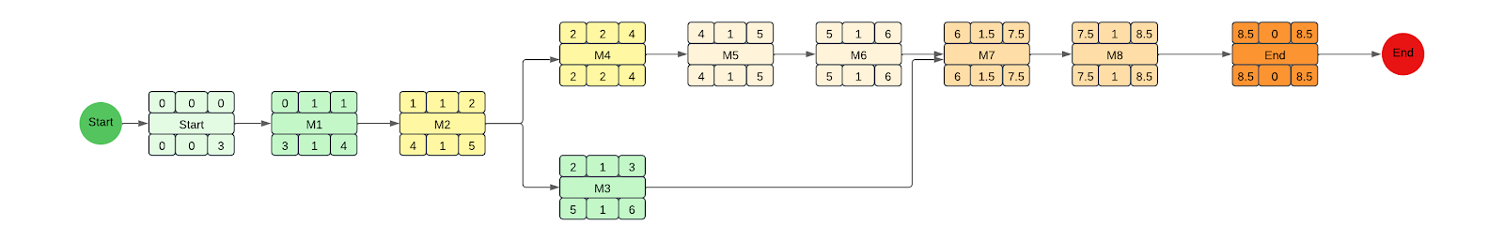
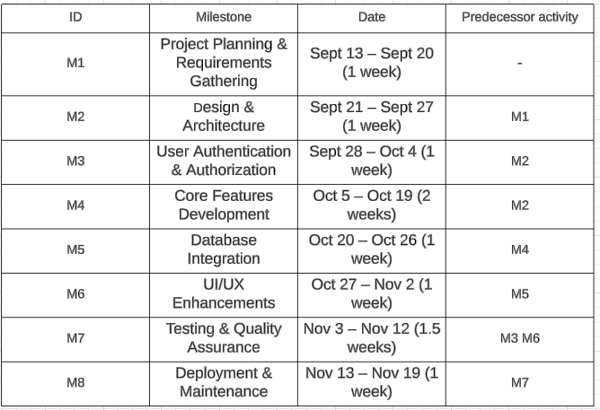
PROJECT MANAGEMENT
Activity Diagram

Slide 13
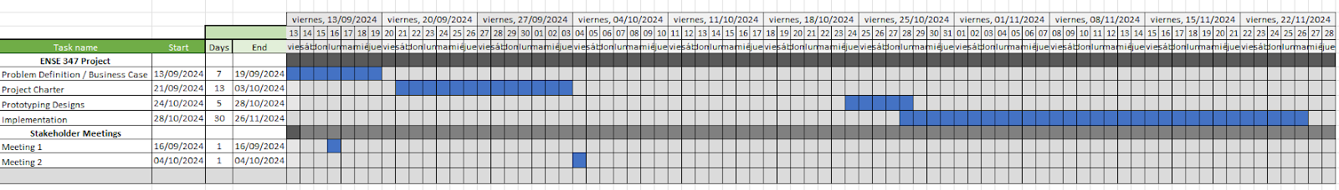
PROJECT MANAGEMENT
Gantt Diagram

Slide 14
CONCLUSION AND FUTURE WORK
Recommendations for Future Design Improvements
Authentication for Medical Professionals: Future versions of the system should incorporate proper authentication mechanisms to ensure that only authorized medical professionals can access sensitive patient and appointment data.
Payment System Integration: Adding payment functionality within the platform would allow patients to pay for services directly through the system, improving convenience and automating the billing process.
EHR Integration: To improve the efficiency of patient care, integrating the system with an Electronic Health Record (EHR) system would provide medical professionals with real-time access to patient medical history and current treatment plans.
Real-time Updates: Implementing real-time notifications would ensure that patients and medical professionals are always in sync with appointment status, cancellations, or rescheduling, providing a more dynamic and responsive experience.
Set Availability by Medical Professionals: Implement the functionality to let each medical professional set their available times, making the scheduling easier, not having to cancel each appointment by hand, as well as implement the schedules when a user is booking an appointment to only let them select the times available.

Slide 15
IN SUMMARY
While the current system serves as a solid foundation for appointment scheduling and patient management, there are ample opportunities for future enhancements that would improve security, usability, and overall functionality.

